Slide 1
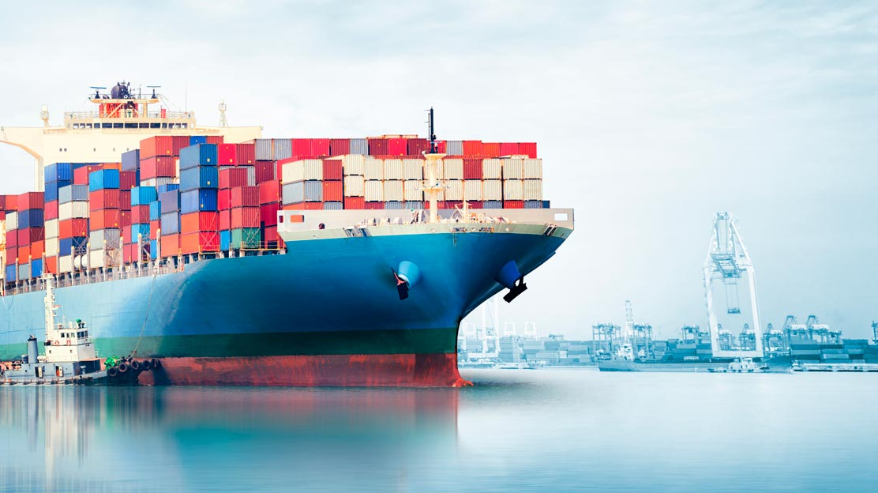
Progress sprint 5 @ Saab
13-11-2019

Slide 2
Contents
Clustering
Heatmap
Main Clustering
Rounding Longitude/Latitude
V1
V2
More Clustering
RNN
Basic version (first results)
Newer version
Visualization
geoVisualization (??)
Documentation progress

Slide 3
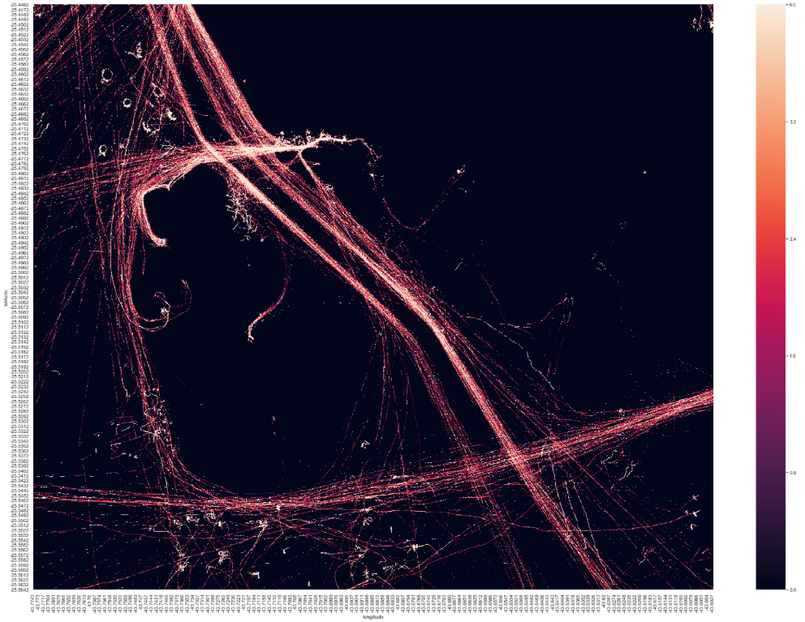
Clustering - Heatmap

Slide 4
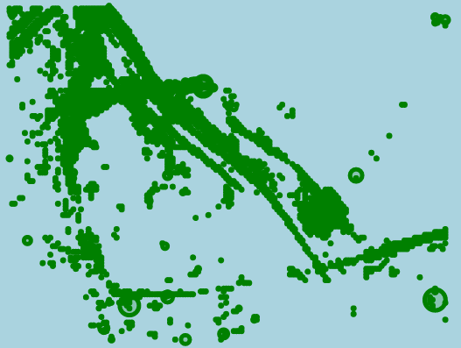

Main Clustering
>200reps

Slide 5
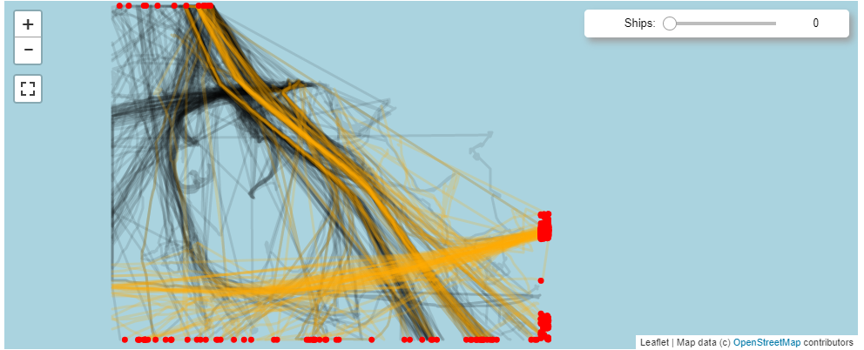
Clustering - Rounding Lat/Long
First version:

Slide 6
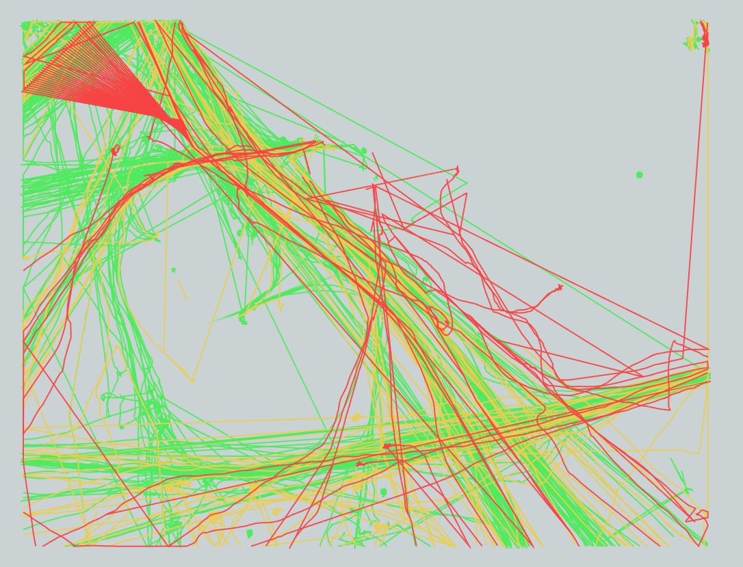
Clustering – Rounding Lat/Long

Slide 7
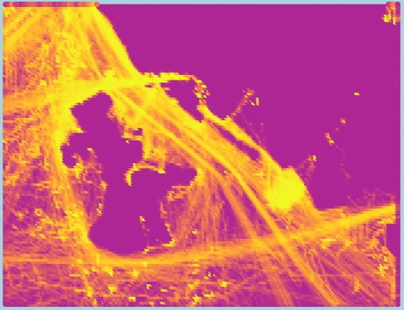
More Clustering
See HTML in Antonio’s folder
Alternative: >200Reps

Slide 8
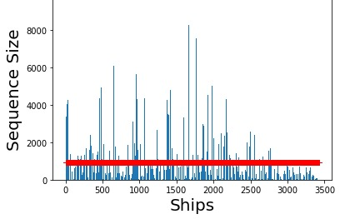
RNN – Basic version
First steps
Unique mmsi’s
Red line = Average

Slide 9
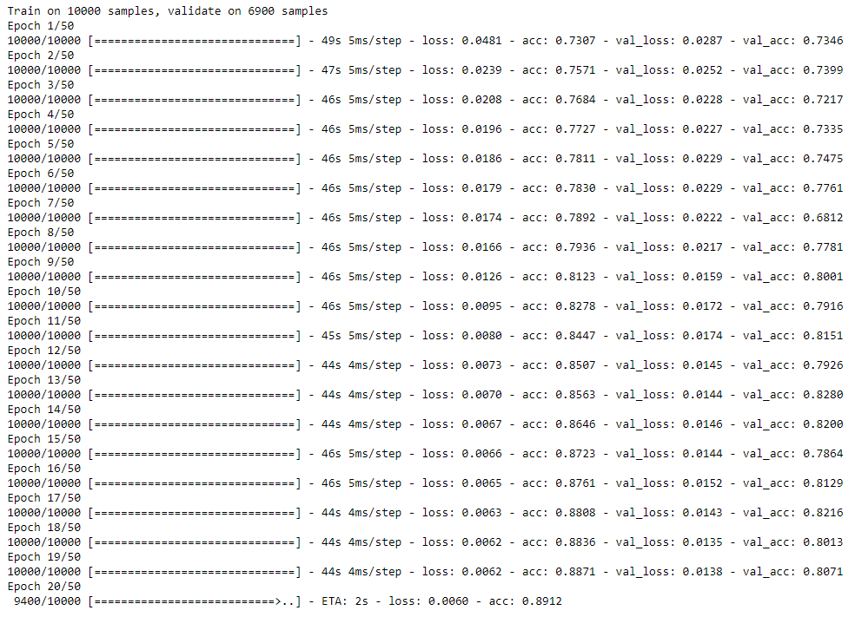
RNN – Basic version

Slide 10
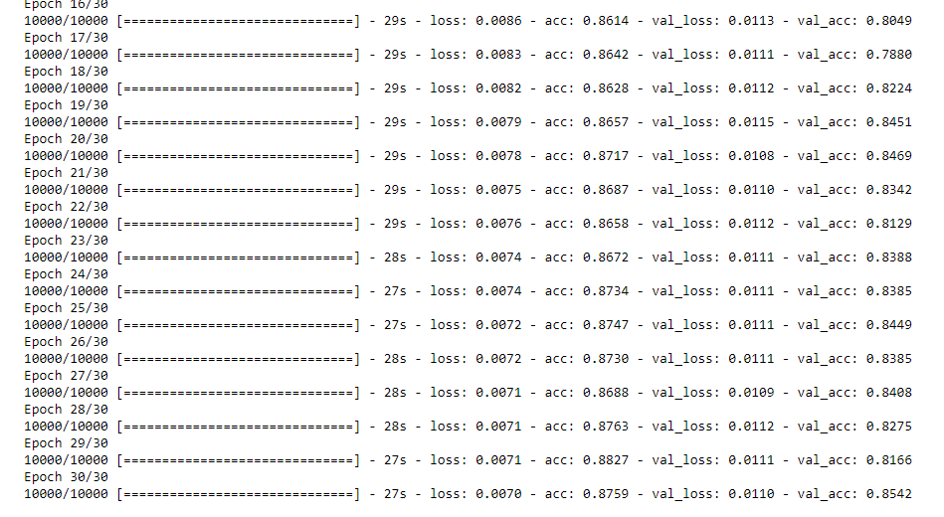
RNN – Newer Version
Computational issues
Jeroen’s advice
Lots of testing
GRU instead of LSTM
Dropout 50%

Slide 11
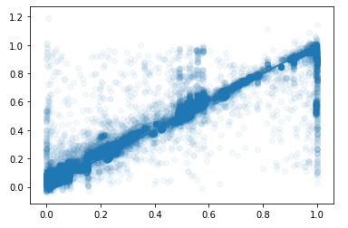
RNN - Visualization
Normalized values
X: Y_values
Y: Y_predictions

Slide 12
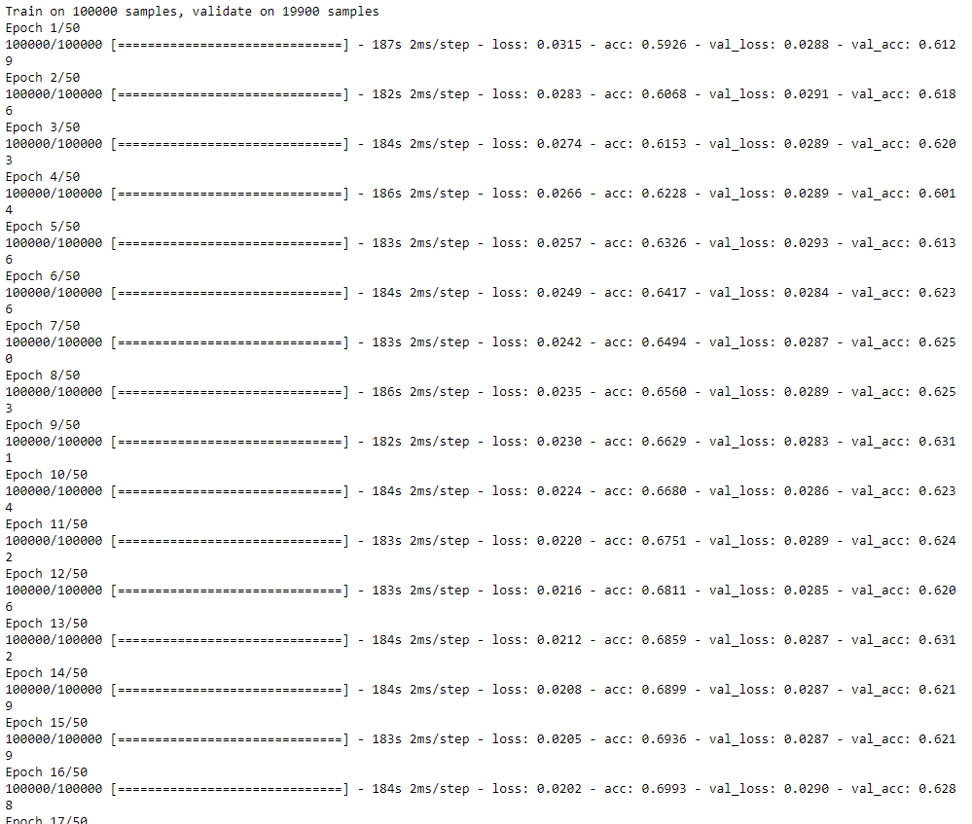
RNN – More Data

Slide 13
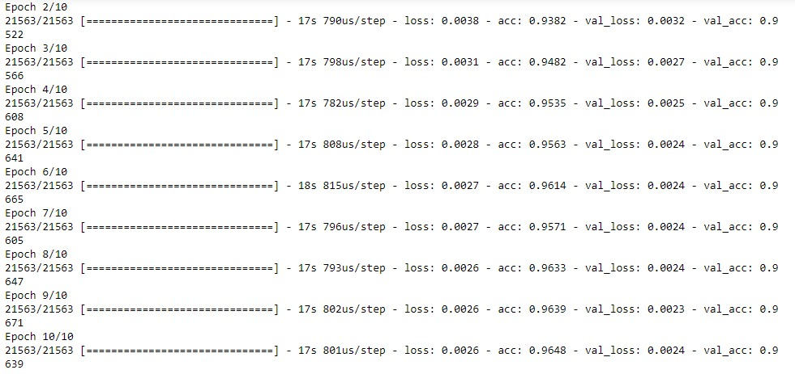
RNN - geoVisualization (??)

Slide 14
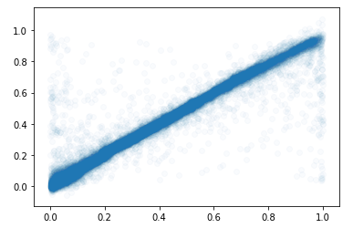
RNN - geoVisualization (??)

Slide 15
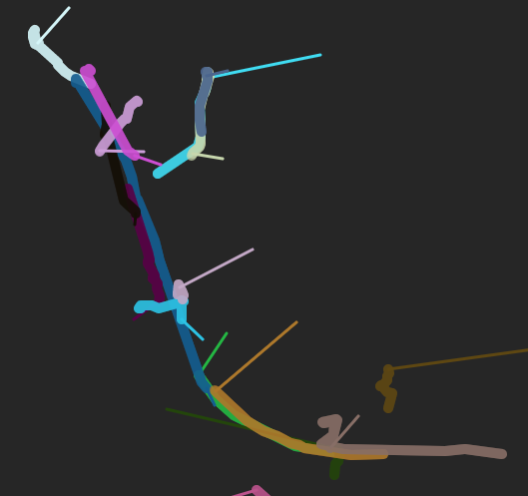
RNN - geoVisualization (??)

Slide 16
Documentation
Scribbr
Expand
Comments

